Slide 1
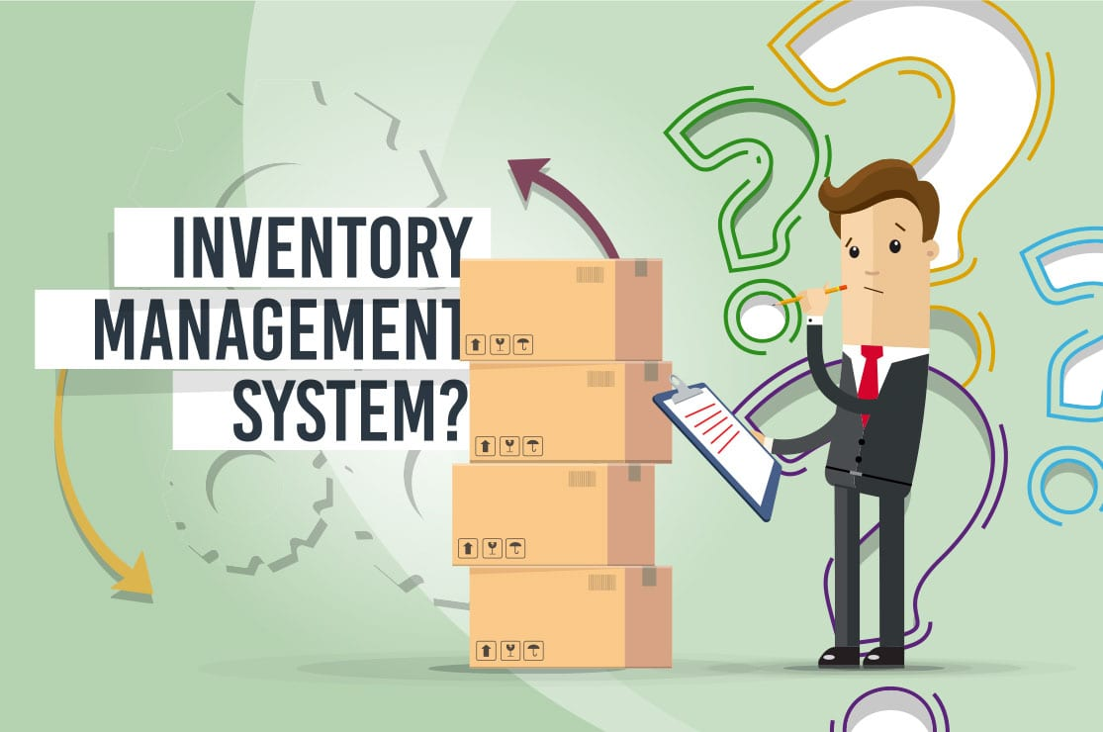
PROJECT REVIEW
FISAT
PRESENTED BY,
SRUTHY E
S4MCA B-50

Slide 2
DESCRIPTION OF THE PROJECT:-
Inventory management software is a software system for tracking inventory levels, orders, sales and deliveries. It can also be used in the manufacturing industry to create a work order, bill of materials and other production-related documents.
The Inventory Management system is used to manage store products and keep track of all goods stock and also can use it to check the purchases history of the store. Basically, we are developing a system to manage/automate some processes of any retail store by using the computer. So by using this system,it can keep record data of products and even all purchases happened in-store.

Slide 3
RELEVANCE OF THE TOPIC:
This system is mainly used for reducing the manual work in the college and make it as system process. It is a computerized process and all the transactions might be happened through this. It helps the authorities for balancing the total stock during the end of the year

Slide 4
OBJECTIVES:-
The primary purpose of inventory management is to ensure there is enough goods or materials to meet demand without creating overstock, or excess inventory. This is a project for the college to maintain the stock in every department. Its main aim is to help the officers to handle the stock easily and they can report it to the nodal officer about the required stock that needed for the department.

Slide 5
EXISTING AND PROPOSED SYSTEM:
In the existing system, when the required stock is not available in the warehouse. The officials might buy it from sub store and may not be included in the balance stock record.
But in the proposed system, every thing that has been bought for use in departments and offices whether it be from the warehouse or outside shops will be recorded in the inventory.

Slide 6
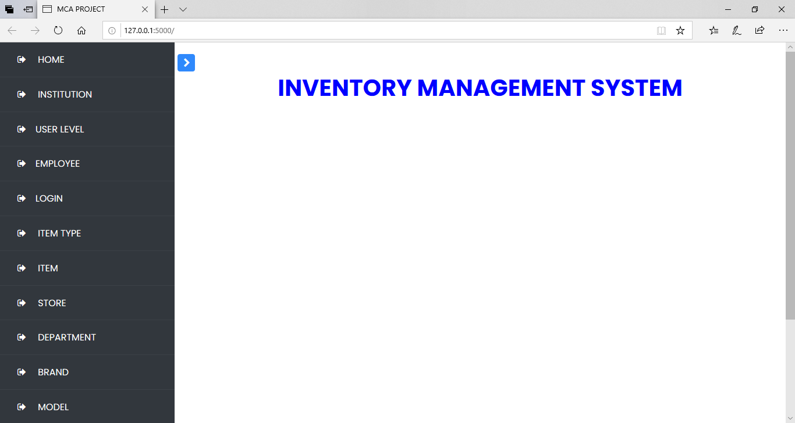
USER INTERFACE

Slide 7
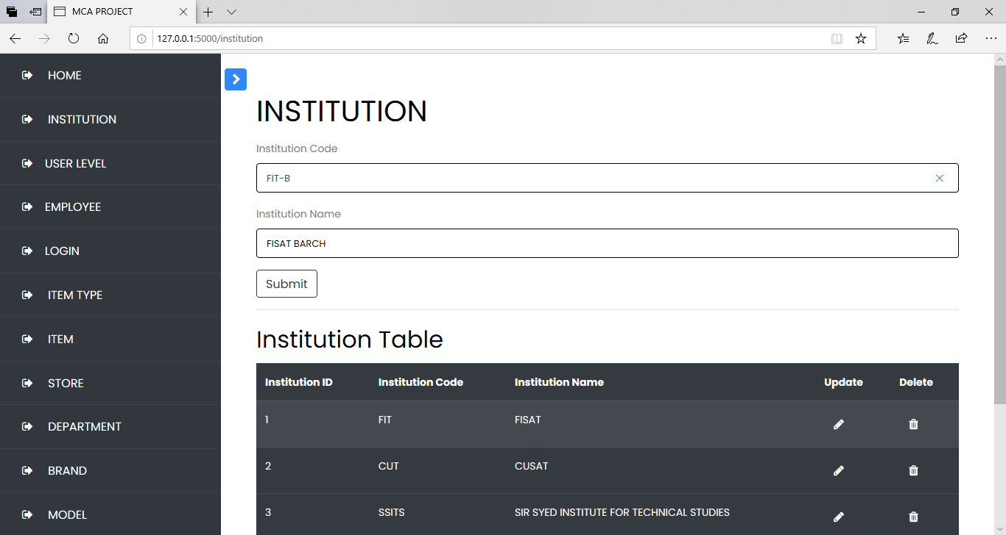

Slide 8
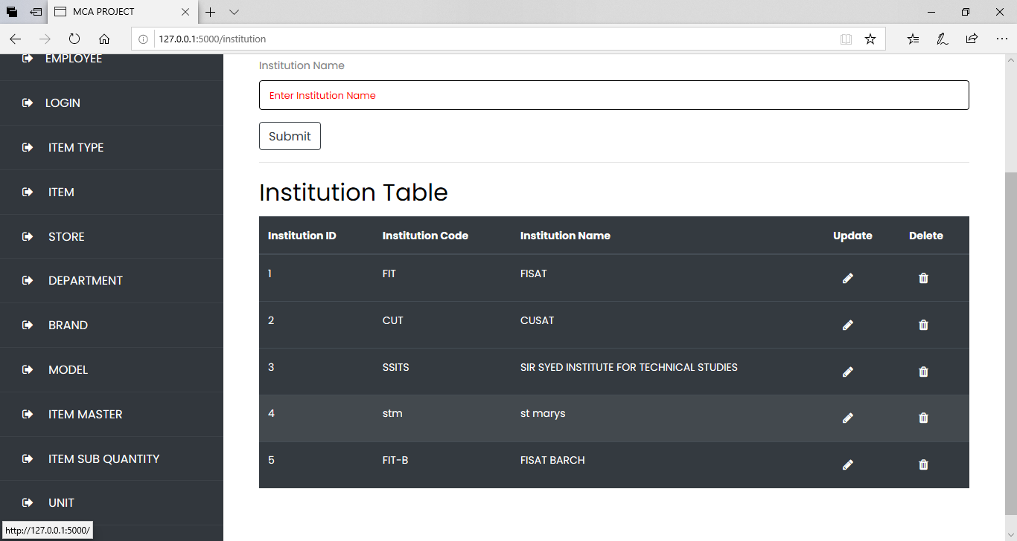

Slide 9
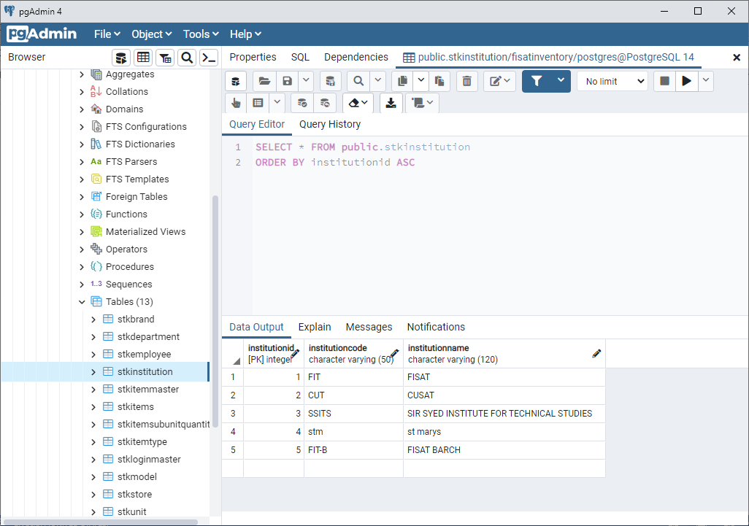

Slide 10
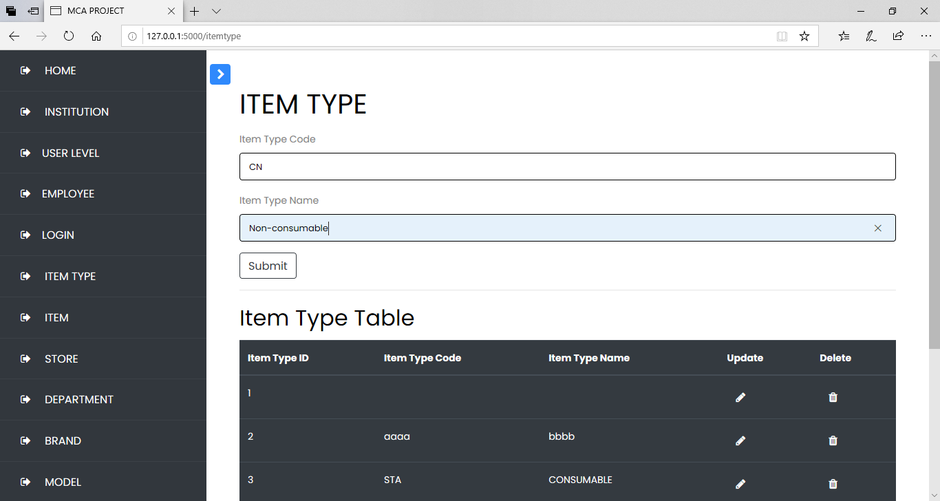

Slide 11
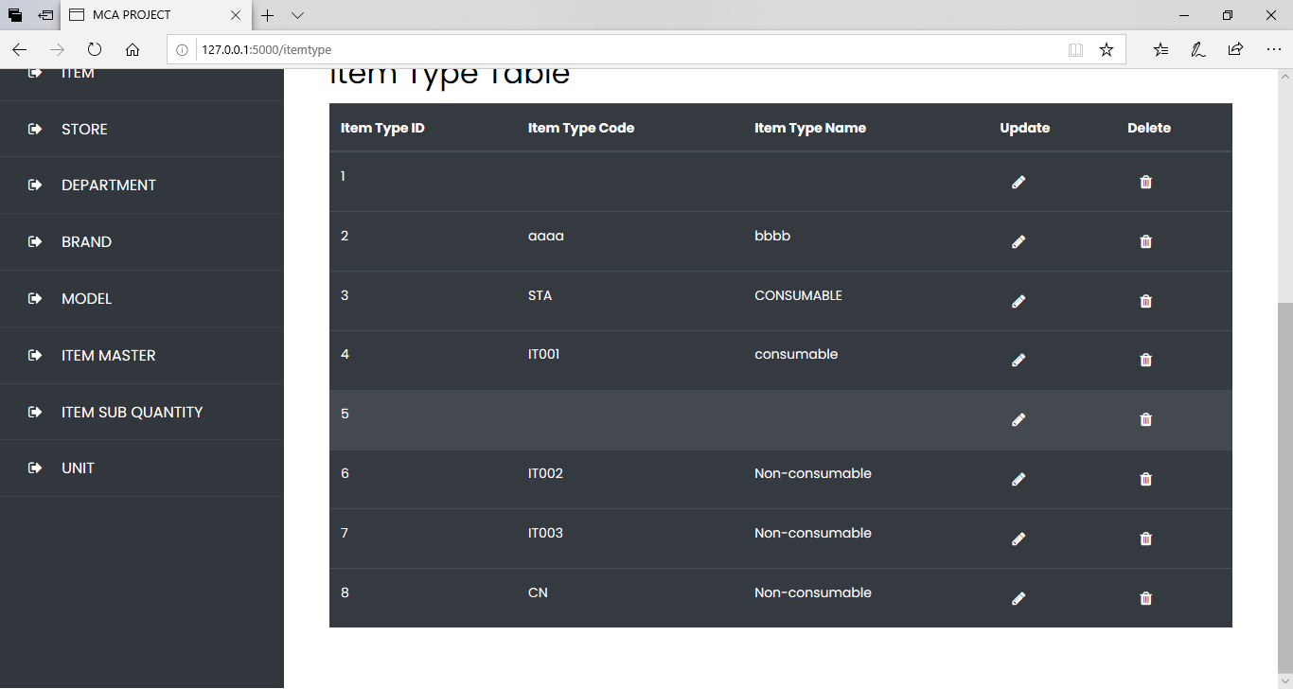

Slide 12
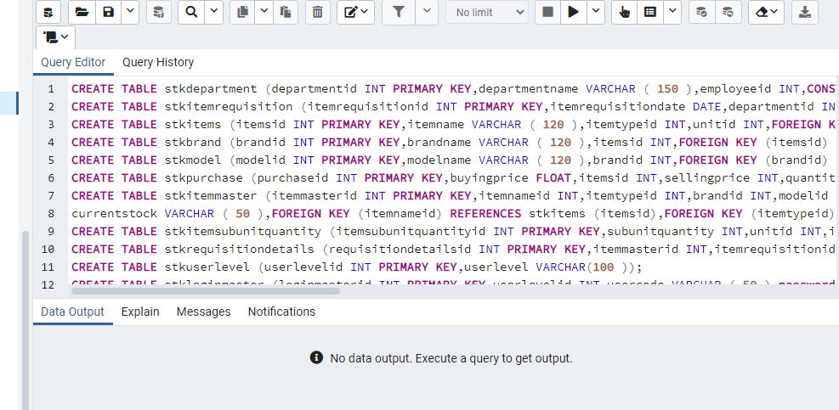
TABLE CREATION

Slide 13
Modules:-
Purchase
Fuel
Repair
Food and beverages

Slide 14
TOOLS USED:-
Back End: Python, postgresql
Front End: HTML,Javascript

Slide 15
THANK YOU…..

